Slide 1
Data Visualizations & Leadership Assignment 3- Data Visuals
Name of the Student: Maisha Khatoon
Student ID: 100899259

Slide 2
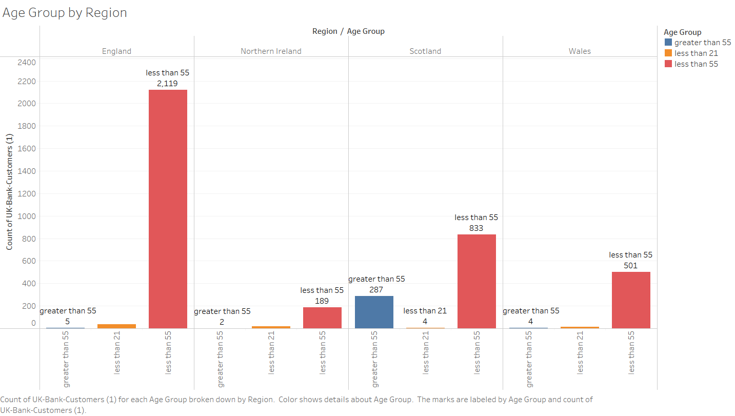
Question 1-Age Group by Region
The data visualization displays the dispersion of enrolments according to different age groups in the year 2015. Each bar corresponds to the enrolment count of a certain age group. Through the examination of the vertical dimension of each bar and the comparison of enrolment figures among different age cohorts, it is possible to discern trends and patterns within the data, which can then be utilized to shape marketing plans and customer service activities.

Slide 3
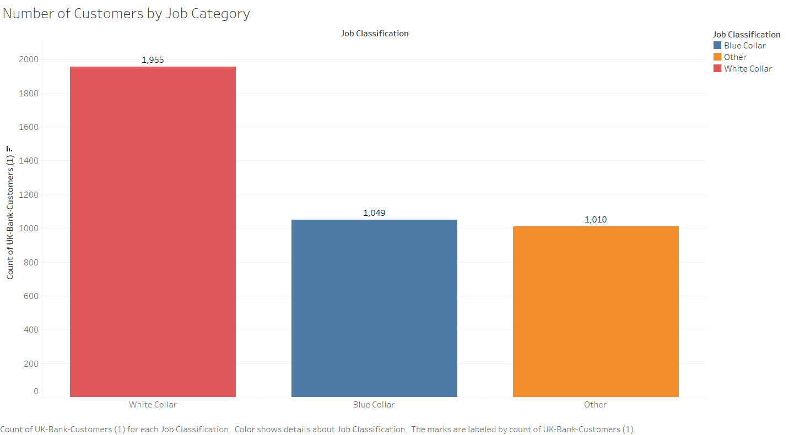
Question 2-Number of Customers by Job Category
The data visualization presents a chart illustrating the enrolment figures categorized by age group for the year 2015. The graph is arranged with age categories on the x-axis and the quantity of enrolments on the y-axis. To conduct an analysis and interpretation of the data, it is advisable to direct your attention towards the vertical dimension of each bar, as it corresponds to the number of enrolments within each age group. By analyzing the customer distribution across various age groups, one might discern trends or patterns in the data, such as the prevalence of enrolments among younger or older age groups. This data can be valuable for comprehending customer demographics and making well-informed choices regarding marketing strategy, product offerings, or customer service activities.

Slide 4
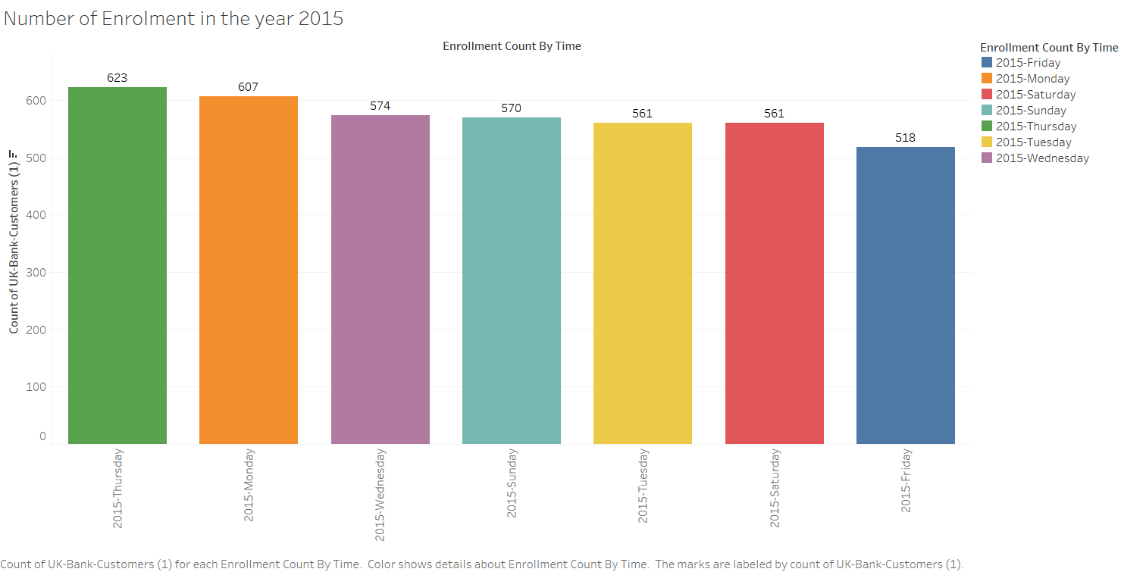
Question 3-Number of Enrolment in the year 2015
The image is a bar graph illustrating the enrolment figures categorized by age group for the year 2015. The graph is partitioned into five distinct portions, with each segment corresponding to a distinct age group. The data is presented lucidly and systematically, facilitating comprehension of the customer distribution across different age groups. To analyze and comprehend the data, it is necessary to scrutinize the height of each bar and make comparisons between the enrolment counts for each age group. This analysis will offer valuable information about the client demographics and facilitate the detection of any discernible trends or patterns in the data.

Slide 5
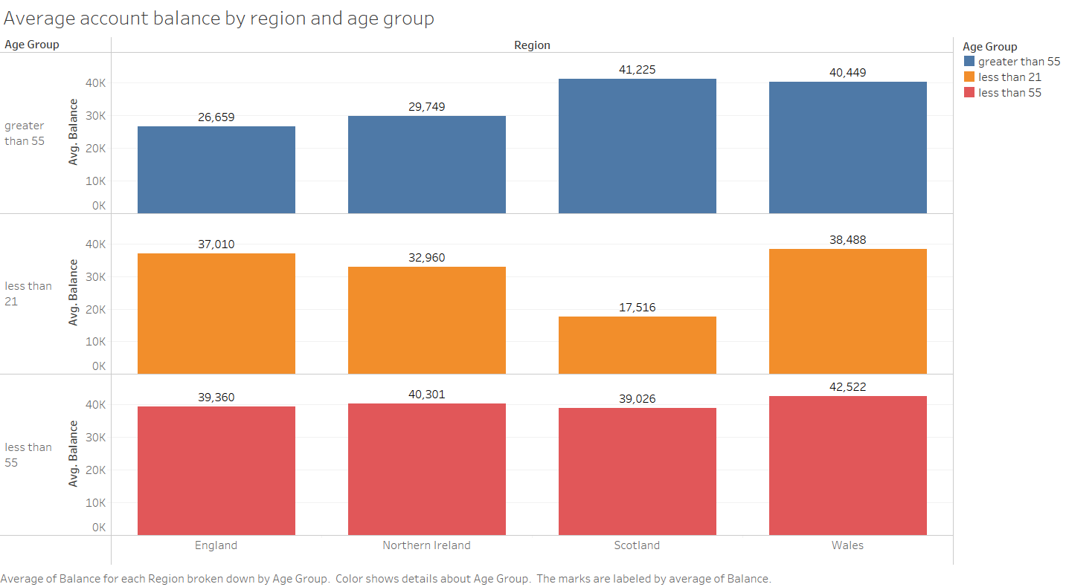
Question 4- Average account balance by region and age group
A 2015 bar chart shows enrolments by age group. The chart has Northern Ireland, Scotland, and two more locations. The age categories are color-coded, and the height of each bar shows enrolments. Focus on bar heights and compare them across age groups and geographies to analyze the data. This comparison can reveal data trends and patterns that can inform marketing and customer service strategies.

Slide 6
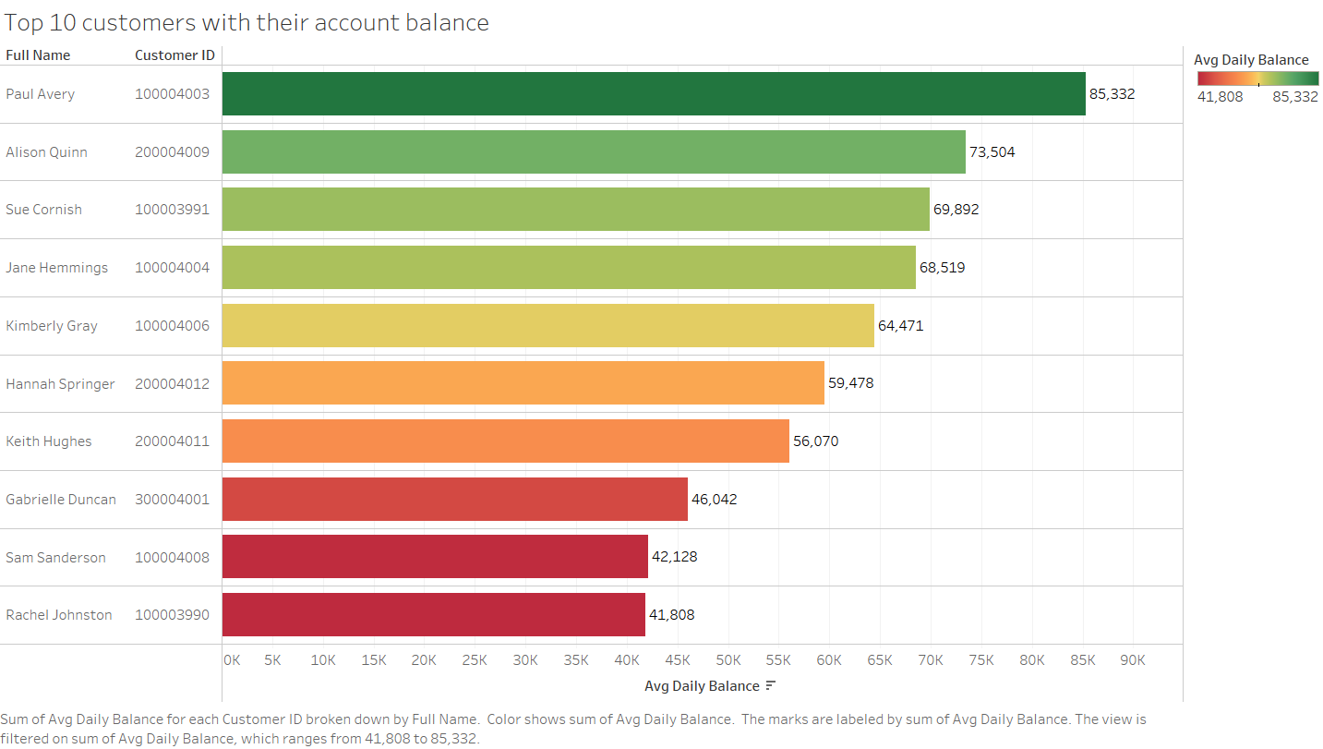
Question 5-Top 10 customers with their account balance
This data picture provides a bar chart of 2015 enrolments by age group. Each bar shows the number of enrolments in a certain age group, and its height denotes its relative number. Trends and patterns can be found by comparing enrolment counts between age groups and bar heights. This data can help with customer demographics and marketing and customer service decisions.

Slide 7
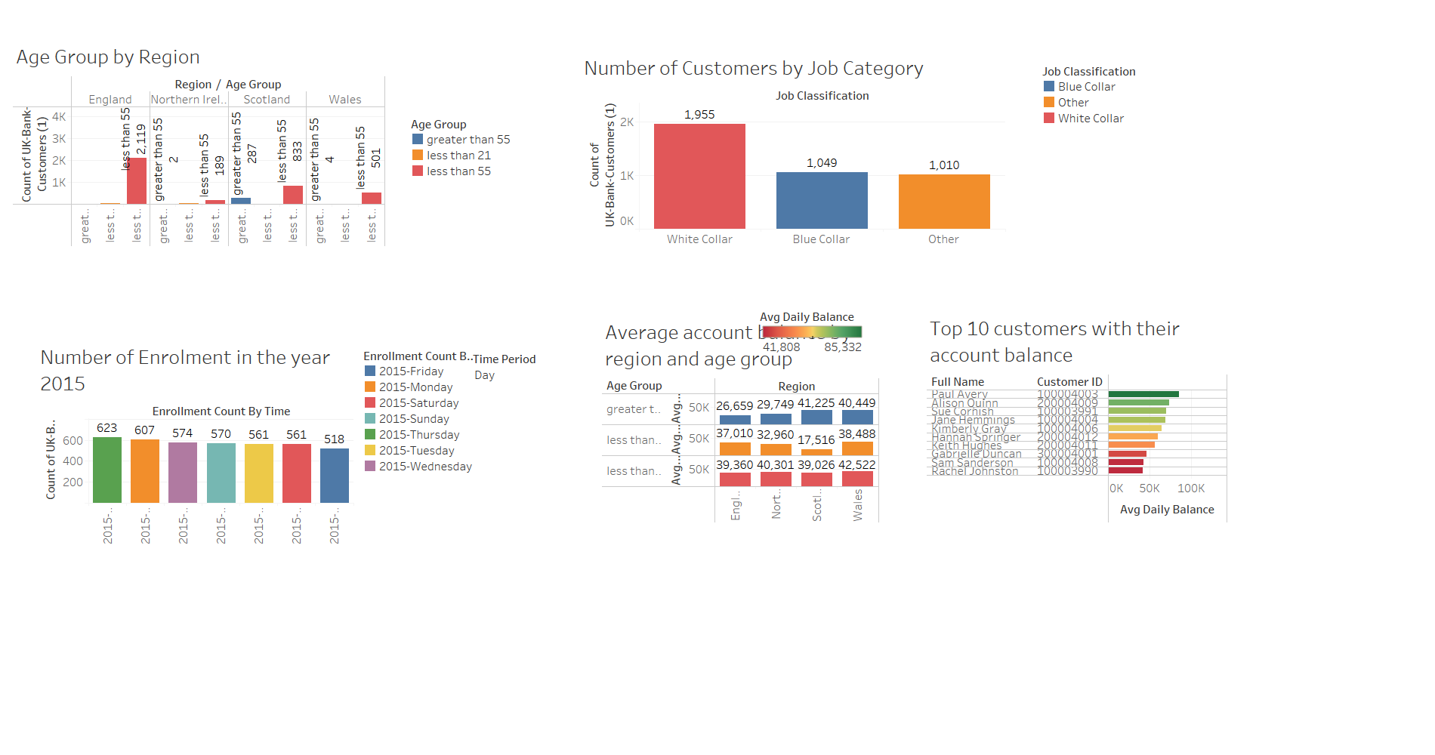
Conclusion- Dashboard
Based on the data, it can be concluded that enrolments in the 25-34 age range increased significantly between 2014 and 2015. This shows that the marketing techniques and efforts were effective in getting more clients in this age range. The data also shows that the UK accounts for the majority of enrolments, with notable growth in this region. This demonstrates that the marketing methods were successful in targeting the UK market. Overall, the data insights indicate that the company has been successful in recruiting more clients from the 25-34 age bracket and the United Kingdom region, which can be ascribed to the efficient marketing tactics in place.

